Slide 1


YEAR 1
Place Value
Compare groups of objects
Compare numbers
Order groups of objects
Order numbers
Block 4 – Week 12

Slide 2

Lesson 1
Step: Compare groups of objects

Slide 3


Fluency
Which group of objects shows the most _______
A
A
B
By how many? _______
1

Slide 4
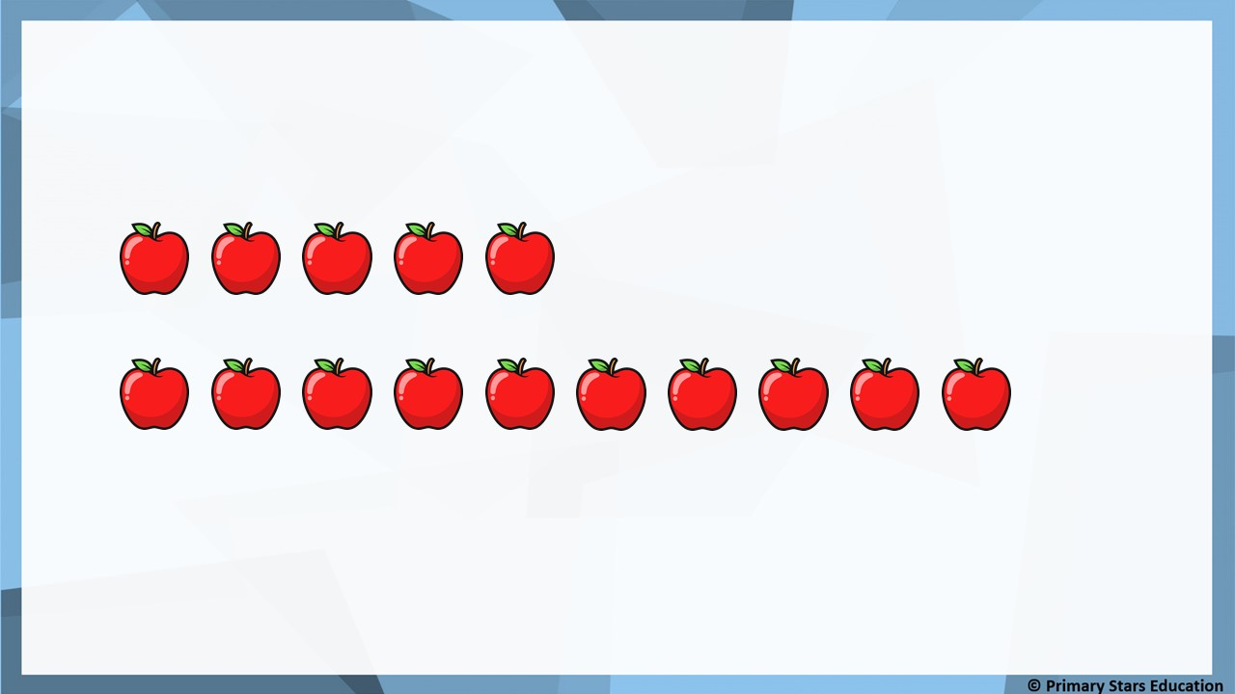
Fluency
B
Which group of objects shows the most? _______
A
B
5
By how many? _______

Slide 5
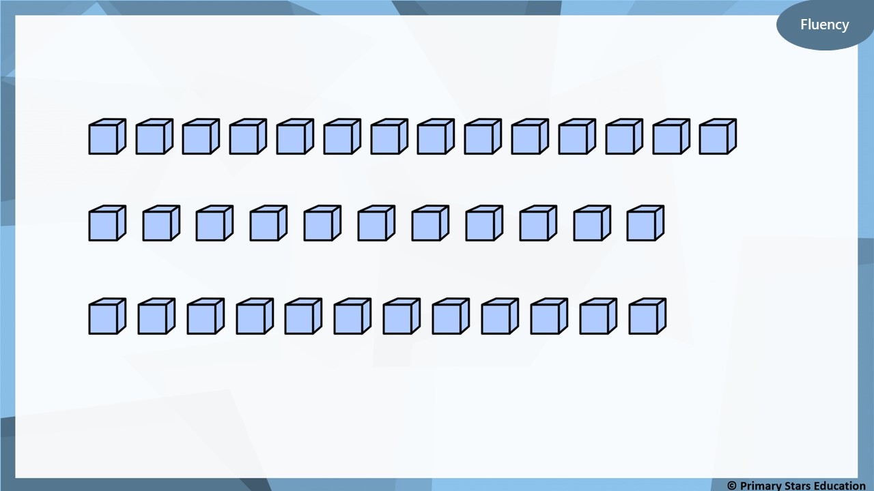
Which group of objects shows the most? _______
A
A
B
C
Which group shows the least? _______
B
How do you know?
B has the least with 11 cubes. A = 14 and C = 12.

Slide 6
Fluency
Complete the sentences by using less than, greater than or
equal to.
 | is ____________________
 | is ____________________
 | is ____________________
greater than
less than
equal to

Slide 7
Fluency
Complete the sentences by using less than, greater than or
equal to.
 | is ____________________
 | is ____________________
 | is ____________________
less than
equal to
greater than

Slide 8
Reasoning
Spot the mistake.
 | is less than
 | is equal to
is greater than
should be less than

Slide 9
Problem solving
How many pencils could go in each box?
How many different ways can you think of?
Least
Most

Slide 10
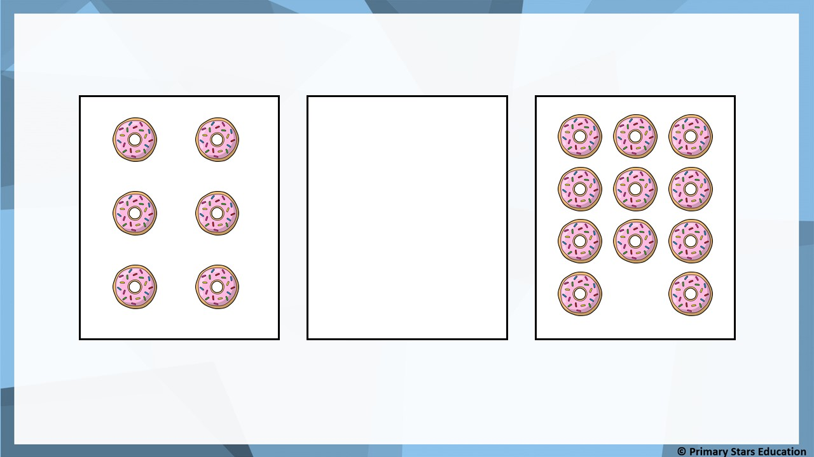
Problem solving
How many doughnuts could go in the box?
More than 6 doughnuts
but
less than 11 doughnuts.
Least
Most

Slide 11
Lesson 2
Step: Compare numbers

Slide 12
Fluency
Which is the greatest number?
11 | 1 | 10
16 | 20 | 13
12 | 15 | 18

Slide 13
Fluency
Which is the smallest number?
10 | 3 | 8
19 | 16 | 9
4 | 7 | 14

Slide 14
Fluency
Use the signs < or > to complete the statements.
9
<
19
10
<
11
14
>
7

Slide 15

Reasoning
I have coloured the smallest number yellow and the greatest number green.
13 | 15 | 7 | 17 | 18 | 6
No
Is Tam correct? _______
Explain your answer.
Tam has coloured the smallest number incorrectly.
6 is the smallest number (not 7).

Slide 16
Problem solving
What numbers could go in the boxes below?
Can you list them all?
15
<
?
____________________________________
16, 17, 18, 19, 20
9
>
?
____________________________________
8, 7, 6, 5, 4, 3, 2, 1, 0
10
<
?
____________________________________
11, 12, 13, 14, 15, 16, 17, 18, 19, 20

Slide 17
Lesson 3
Step: Order groups of objects

Slide 18



Fluency
Recap: Which group has the smallest amount? _______
A
A
B
By how many? _______
1

Slide 19

Fluency
Recap: Which group has the greatest amount? _______
A
A
B
By how many? _______
1

Slide 20
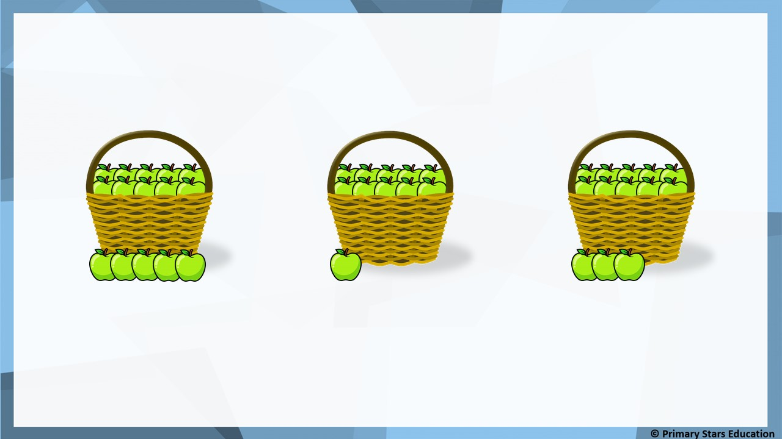
Fluency
Order the groups from smallest to greatest.
Each basket contains 10 objects.
A
B
C
smallest
B
C
A
greatest

Slide 21



Fluency
Order the groups from smallest to greatest.
Each jar contains 10 objects.
A
B
C
smallest
C
A
B
greatest

Slide 22

Fluency
Order the groups from greatest to smallest.
Each box contains 10 objects.
A
B
C
greatest
A
C
B
smallest

Slide 23
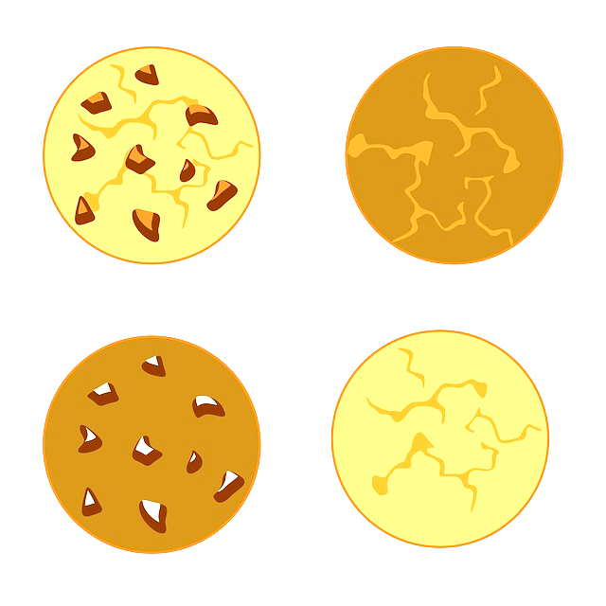

Fluency
Order the groups from greatest to smallest.
Each plate contains 10 objects.
A
B
C
greatest
C
B
A
smallest

Slide 24

Reasoning
I have ordered the numbers from smallest to greatest.
17 | 15 | 11 | 10 | 9 | 6
Is Matt correct? _______
No
Explain your answer.
Matt has ordered the numbers from greatest to smallest.

Slide 25
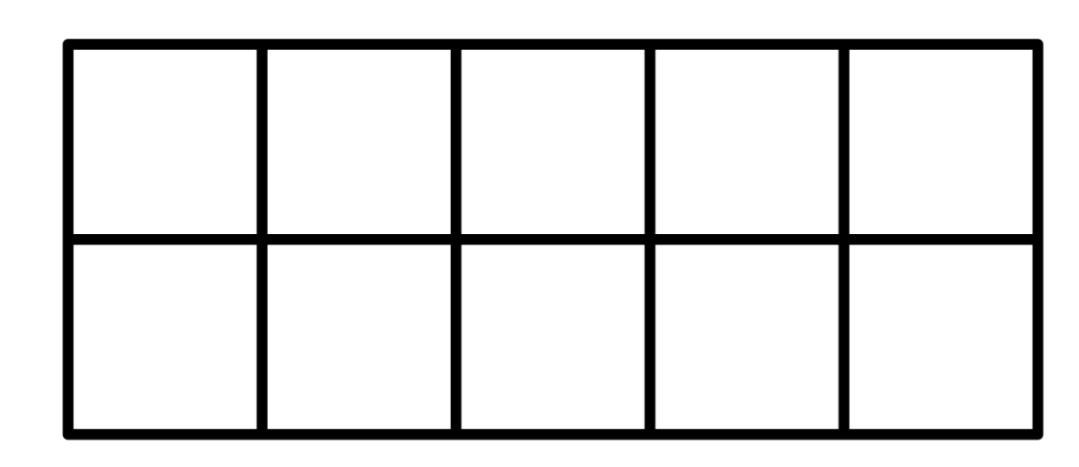
Problem solving
How many counters could go in the ten frames to make them correct?
smallest
greatest
greatest
smallest

Slide 26
Problem solving
How many counters could go in the boxes to make them correct?
smallest
greatest

Slide 27
Lesson 4
Step: Order numbers

Slide 28


Fluency
Order the numbers from smallest to greatest.
13
18
9
smallest
9
13
18
greatest

Slide 29
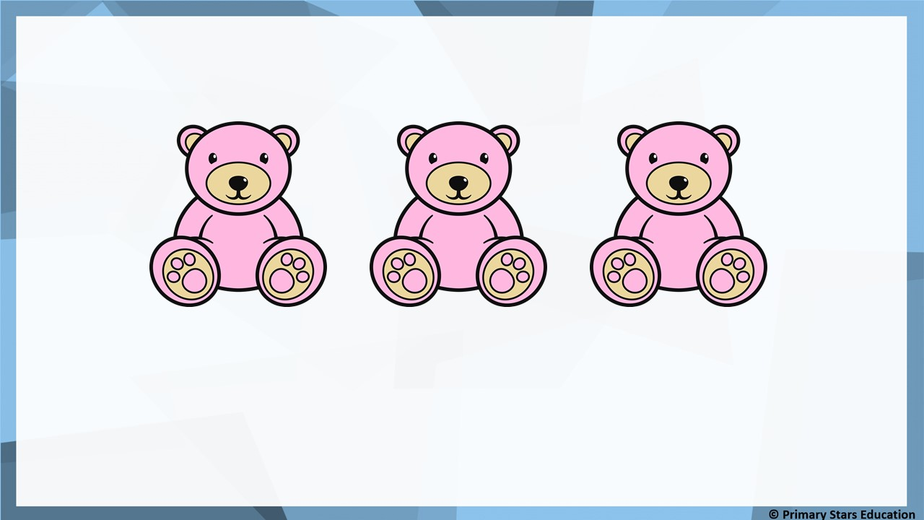
Fluency
Order the numbers from smallest to greatest.
6
19
16
smallest
6
16
19
greatest

Slide 30
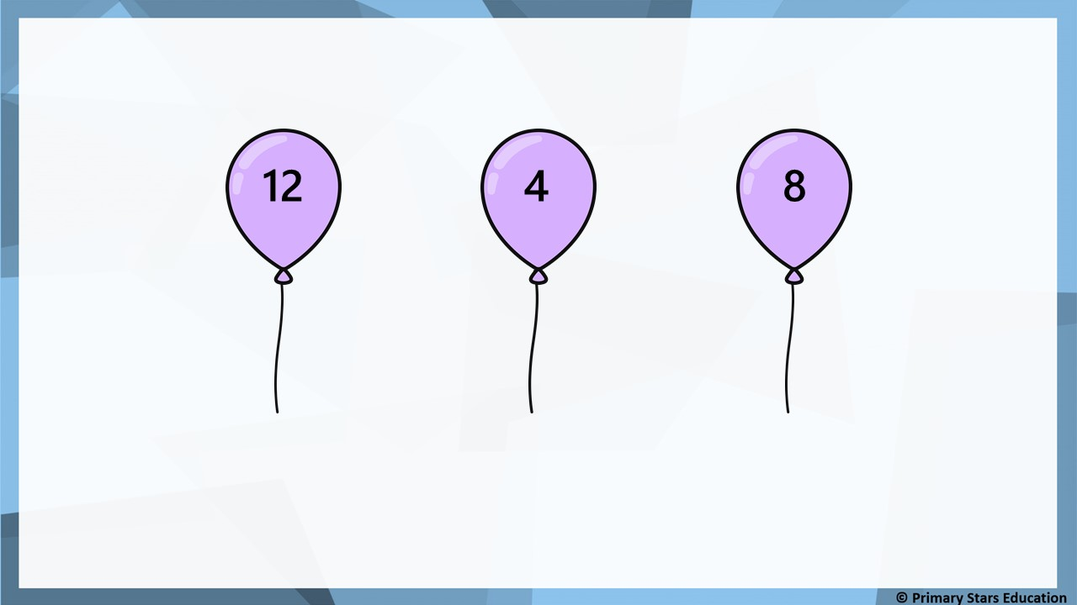
Fluency
Order the numbers from smallest to greatest.
smallest
4
8
12
greatest

Slide 31
Fluency
Order the numbers from greatest to smallest.
14
4
11
greatest
14
11
4
smallest

Slide 32
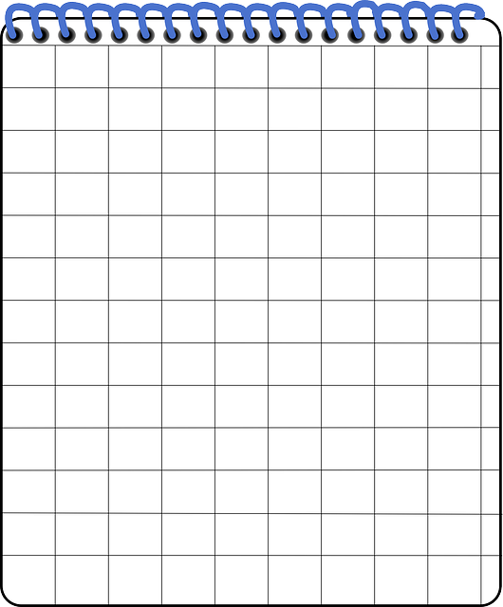
Fluency
Order the numbers from greatest to smallest.
18
19
16
greatest
19
18
16
smallest

Slide 33

Fluency
Order the numbers from greatest to smallest.
10
20
15
greatest
20
15
10
smallest

Slide 34
Fluency
Order the numbers from smallest to greatest.
The first one has been done for you.
3
4
5
6
9
5
10
7
16
14
7
11
10
9
8
8
4
13
12
12
15
6
13
14
15
16
11

Slide 35
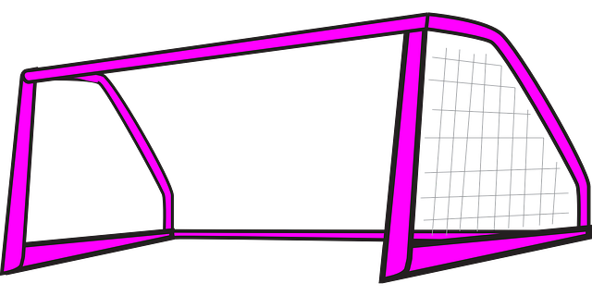

Fluency
Three children were playing football.
They decided to see how many goals they could score in 1 minute.
Mo scored 5
Matt scored 7
Sue scored 6
Put the children’s scores in order from smallest to greatest.
smallest
5
6
7
greatest

Slide 36

Reasoning
I have ordered these numbers from greatest to smallest.
14
12
13
11
Has Dom ordered the numbers correctly? _______
No
Explain your answer.
Dom has placed the number 13 in the incorrect position.
It should come before the number 12.

Slide 37

Problem solving
My number is greater than 9 but less than 16.
What could Jack’s number be?
Possible answers:
10, 11, 12, 13, 14 or 15.

