Slide 2
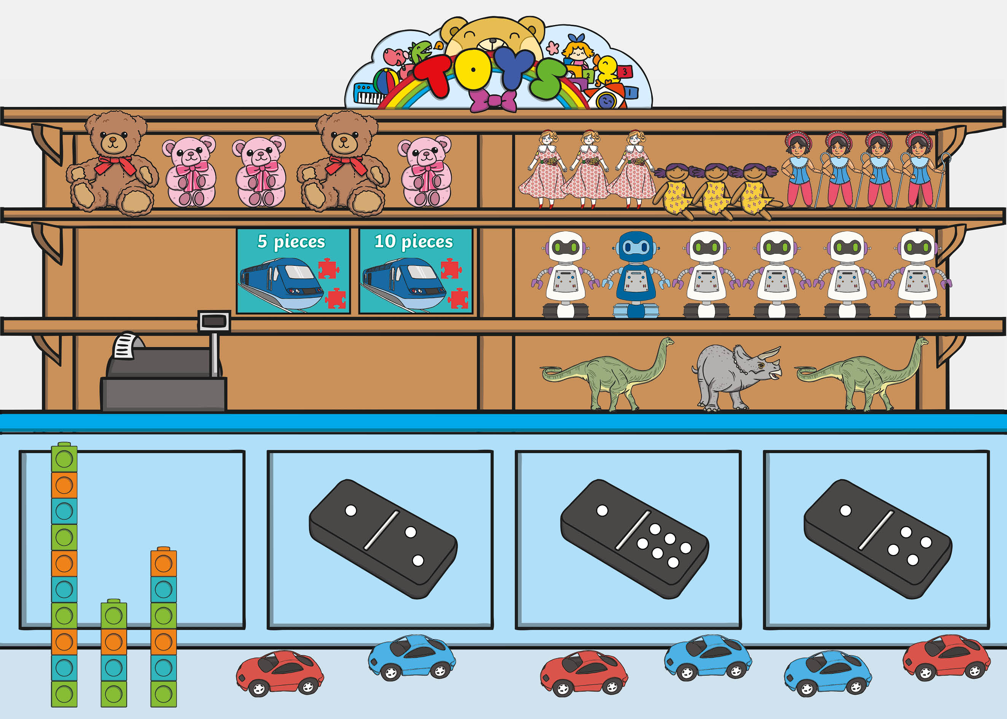

Slide 3


back to the picture
next

Slide 4
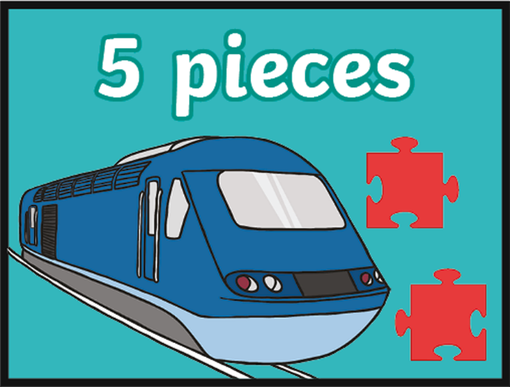
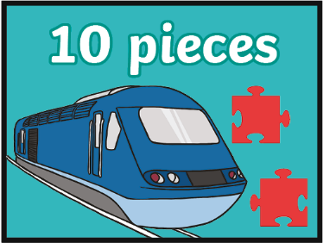
back to the picture
next

Slide 5
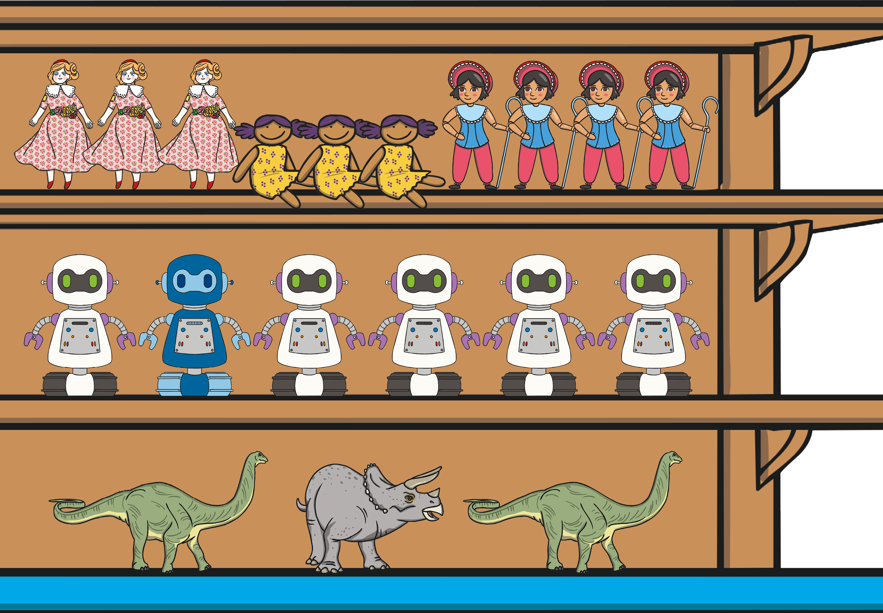
back to the picture
next

Slide 6


back to the picture
next

Slide 7
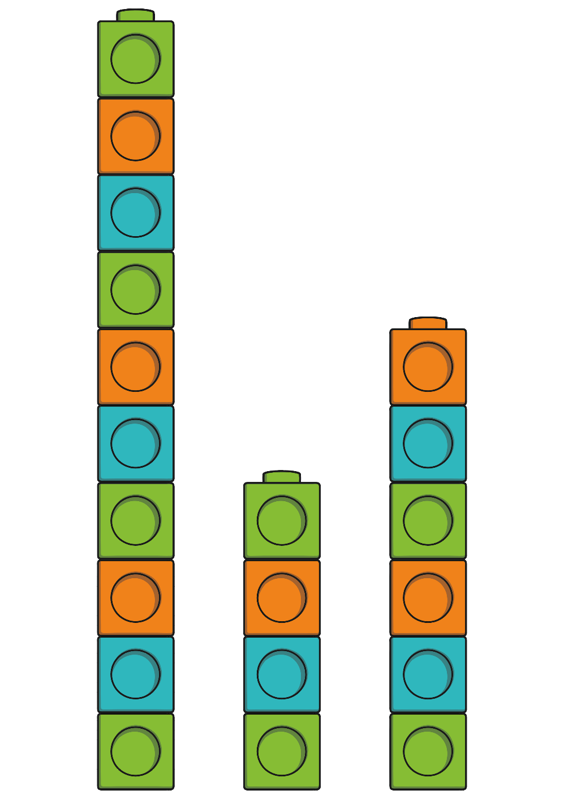
back to the picture
next

Slide 8
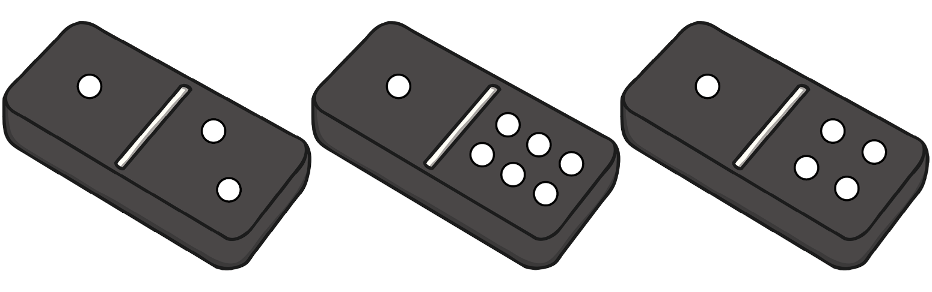
back to the picture
end

